Slide 1
FINANCIAL MANAGEMENT
BY: ANCHAL JAIN
B.TECH 7TH SEM
UNIT-3

Slide 2
Meaning of Leverage:
The word ‘leverage’, borrowed from physics, is frequently used
management.
in financial
The object of application of which is made to gain higher financial benefits compared to the fixed charges payable, as it happens in physics i.e., gaining larger benefits by using lesser amount of force.
Leverage results from using borrowed capital as a funding source when investing to expand the firm's asset base and generate returns on risk capital.
Leverage is an investment strategy of using borrowed money—specifically, the use of various financial instruments or borrowed capital—to increase the potential return of an investment.
Leverage can also refer to the amount of debt a firm uses to finance assets. When one refers to a company, property or investment as "highly leveraged," it means that item has more debt than equity.

Slide 3
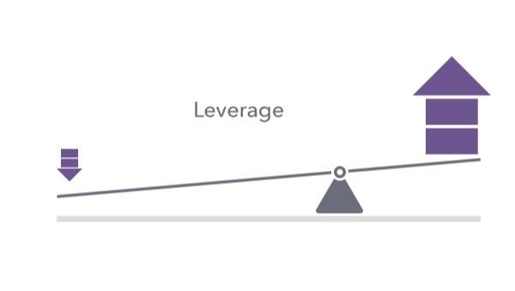
Definitions of Leverage:
Some definitions are given to have a clear idea about leverage:
According to Ezra Solomon:
“Leverage is the ratio of net returns on shareholders equity and the net rate of return on capitalisation”.
According to J. C. Van Home:
“Leverage is the employment of an asset or funds for which the firm pays a fixed cost of fixed return.”

Slide 4
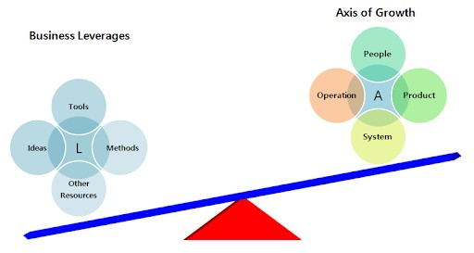

Slide 5
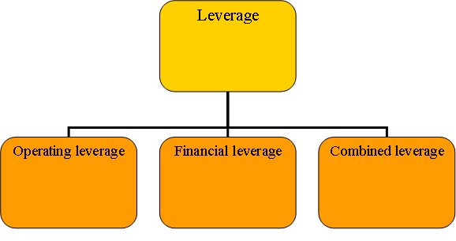
Types of Leverage:
Leverage are the three types:
Operating leverage
Financial leverage
Combined leverage

Slide 6
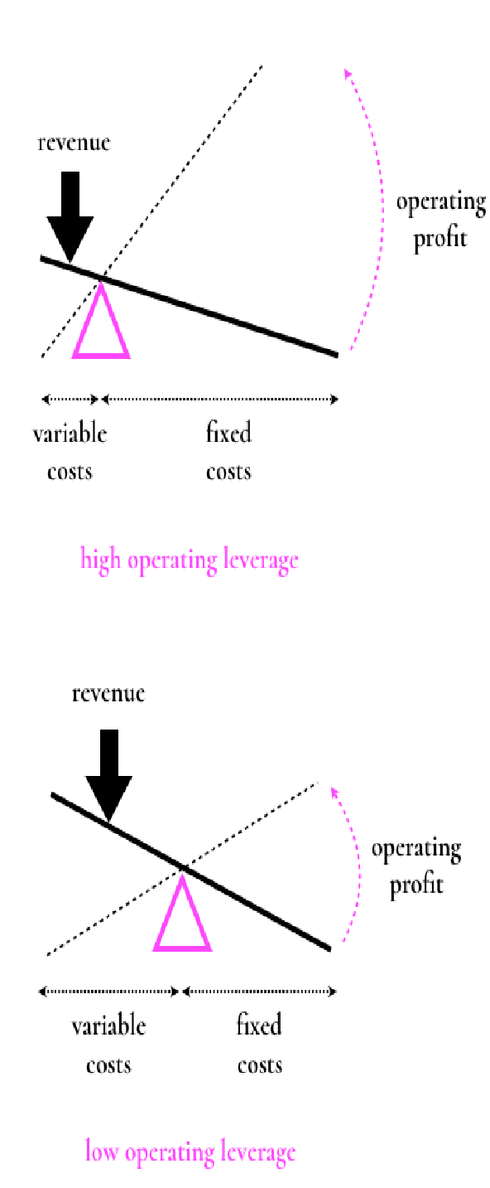
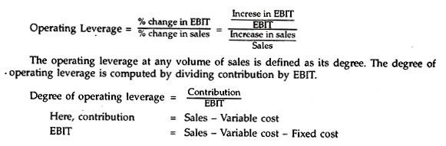
1. Operating Leverage:
Operating leverage refers to the use of fixed operating costs such as depreciation, insurance of assets, repairs and maintenance, property taxes etc. in the operations of a firm. But it does not include interest on debt capital. Higher the proportion of fixed operating cost as compared to variable cost, higher is the operating leverage, and vice versa.
Degree of Operating Leverage:
The earnings before interest and taxes (i.e., EBIT) changes with increase or decrease in the sales volume. Operating leverage is used to measure the effect of variation in sales volume on the level of EBIT.
The formula used to compute operating leverage is:

Slide 7
Importance of Operating Leverage:
It gives an idea about the impact of changes in sales on the operating income of the firm.
High degree of operating leverage magnifies the effect on EBIT for a small change in the
sales volume.
High degree of operating leverage indicates increase in operating profit or EBIT.
High operating leverage results from the existence of a higher amount of fixed costs in the
total cost structure of a firm which makes the margin of safety low.
High operating leverage indicates higher amount of sales required to reach break-even point.
Higher fixed operating cost in the total cost structure of a firm promotes higher operating leverage and its operating risk.
A lower operating leverage gives enough cushion to the firm by providing a high margin of
safety against variation in sales.

Slide 8
2.Financial Leverage:
Financial leverage is primarily concerned with the financial activities which involve raising of funds from the sources for which a firm has to bear fixed charges such as interest expenses, loan fees etc. These sources include long-term debt (i.e., debentures, bonds etc.) and preference share capital.
Degree of Financing Leverage:
Financing leverage is a measure of changes in operating profit or EBIT on the levels of earning per share.
It is computed as:
Financial leverage = Percentage change in EPS / Percentage change in EBIT = Increase in EPS / EPS / Increase in EBIT/EBIT
The financial leverage at any level of EBIT is called its degree. It is computed as ratio of EBIT to the profit before tax (EBT).
Degree of Financial leverage (DFL) = EBIT / EBT
The value of degree of financial leverage must be greater than 1. If the value of degree of financial leverage is 1, then there will be no financial leverage.

Slide 9
The importance of financial leverage:
It helps the financial manager to design an optimum capital structure. The optimum capital structure implies that combination of debt and equity at which overall cost of capital is minimum and value of the firm is maximum.
It increases earning per share (EPS) as well as financial risk.
A high financial leverage indicates existence of high financial fixed costs and high financial risk.
It helps to bring balance between financial risk and return in the capital structure.
It shows the excess on return on investment over the fixed cost on the use of the funds.
It is an important tool in the hands of the finance manager while determining the amount of debt in the capital structure of the firm.

Slide 10
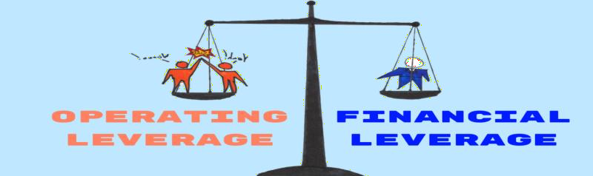
Difference between Operating Leverage and Financial Leverage:
Operating leverage is related to the firm’s operating cost structure while Financial leverage is related to the firm’s capital structure.
Operating Leverage is helpful in measuring the business risk of the firm while
Financial Leverage is helpful in measuring the financial risk of the firm.
Operating Leverage is determined by the relationship between Sales revenue and EBIT (Operating Income) of the firm while Financial Leverage is determined by the relationship between EBIT (Operating Income) and EPS (Earning Per Share) of the firm.
Higher Degree of Operating Leverage (DOL) shows the higher degree of Business risk to the firm while Higher Degree of Financial Leverage (DFL) shows the higher degree of Financial risk of the firm.

Slide 11
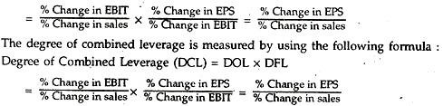
3. Combined Leverage:
Operating leverage shows the operating risk and is measured by the percentage change in EBIT due to percentage change in sales. The financial leverage shows the financial risk and is measured by the percentage change in EPS due to percentage change in EBIT.
The combined leverage can be measured with the help of the following formula:
Combined Leverage = Operating leverage x Financial leverage
If a firm has both the leverages at a high level, it will be very risky proposition. Therefore, if a firm has a high degree of operating leverage the financial leverage should be kept low as proper balancing between the two leverages is essential in order to keep the risk profile within a reasonable limit and maximum return to shareholders.

Slide 12
Importance of Combined Leverage:
It indicates the effect that changes in sales will have on EPS.
It shows the combined effect of operating leverage and financial leverage.
A combination of high operating leverage and a high financial leverage is very risky situation because the combined effect of the two leverages is a multiple of these two leverages.
A combination of high operating leverage and a low financial leverage indicates that the
management should be careful as the high risk involved in the former is balanced by the later.
A combination of low operating leverage and a high financial leverage gives a better situation for maximising return and minimising risk factor, because keeping the operating leverage at low rate full advantage of debt financing can be taken to maximise return. In this situation the firm reaches its BEP at a low level of sales with minimum business risk.
A combination of low operating leverage and low financial leverage indicates that the firm losses profitable opportunities.

Slide 13
Conclusion:
In the Leverage analysis, the main focus is on the measurement of the relationship between the two variables rather than measuring the variables.
The measurement of leverages is the technique used by the business firms to measure the Risk – Return relationship of the firm operating and financial activities.
Leverage is the term which is commonly used to describe the organizations’ ability to utilize the assets which are having fixed costs (or) different sources of funds to increase the returns to the firm.
It is important to do timely and accurate leverage analysis for success of a firm.
The value of degree of financial leverage must be greater than 1. If the value of degree of financial leverage is 1, then there will be no financial leverage.

Slide 14


